Slide 1
Workers’ Compensation in Alberta
Engineering Safety and Risk Management Program 2019

Slide 2
Learning Objectives
By the end of the presentation, you will be able to:
Explain the history and funding principles of WCB.
Appraise how workers’ compensation is administered.
Analyze the link between WCB premiums and changing companies’ safety culture.
Explain how WCB will apply to you in the future as an engineer and a manager.

Slide 3
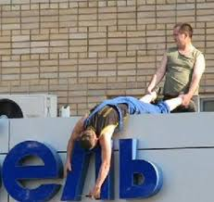

Slide 4
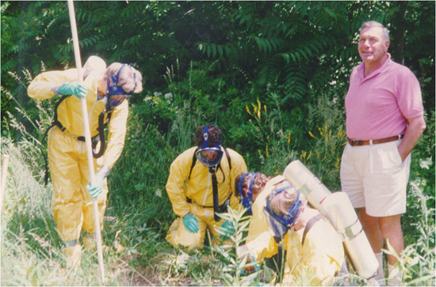

Slide 5
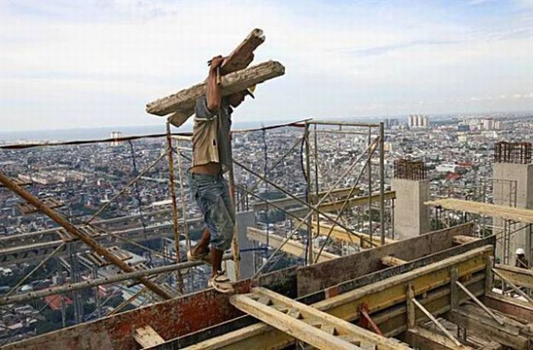

Slide 6
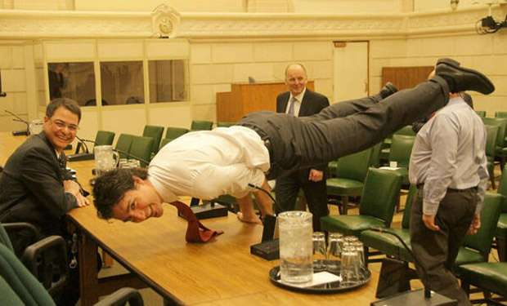

Slide 7
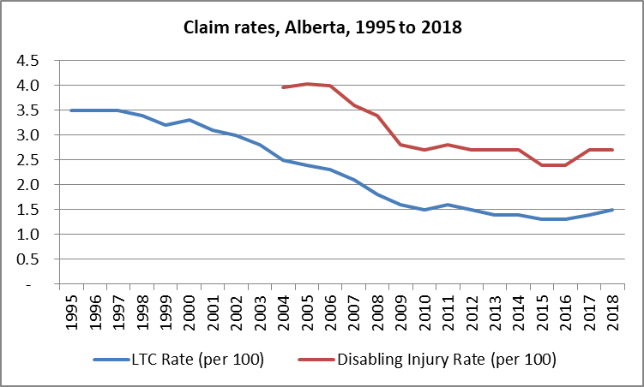
The Driver for WCB
Steady progress, but more opportunity exists.

Slide 8
WCB Coverage in Alberta
Year | Employers | Payroll | Workers | Premiums | Disabling Injuries
2013 | 184,000 | $100.5B | 2.0M | $1.2B | 53,000
2014 | 191,000 | $106.9B | 2.1M | $1.2B | 54,000
2015 | 192,000 | $104.8B | 2.0M | $1.1B | 47,000
2016 | 189,000 | $98.2B | 1.8M | $1.1B | 43,000
2017 | 188,000 | $99.8B | 1.8M | $1.1B | 48,000
2018 | 184,000 | $102.4B | 1.9M | $1.1B | 49,000

Slide 9
Impact of Workplace Injuries
Workplace injury has an enormous impact on Alberta’s economy.
On average in Alberta:
1 worker is killed every 3.5 days (over the past 3 years).
A worker suffers a disabling injury every 12 minutes.
Nearly 150,000 people are hurt at work every year and 28,000 of them lose time from the job.
The annual cost of paying for these claims amounts to about $800 million in claim costs alone.
Annual premiums collected: approximately $1.1 billion.
We insure more than $100 billion in employer payroll.
Over $10 billion in future claim costs for past and current injuries.

Slide 10
Workers’ Compensation History
Canadian workplace at the turn-of-the-century:
Workplace injuries adjudicated under common law.
Common law of negligence – did the employer fail to exercise ‘due care’?
Contributory negligence – did the worker fail to exercise reasonable care?
Fellow-servant doctrine – employers not liable for injuries caused by co-workers.
Assumption of risk – workers assumed liability for accidents caused by risks common to employment.

Slide 11
Workers’ Compensation History
Industrialization – death toll rises
Public sentiment turns
Fundamental change in 1913 (Ontario)
Sir William Meredith
“…the true aim of a compensation law is to provide for the injured workman and his dependents and to prevent their becoming a charge upon their relatives or friends or upon the community at large.”

Slide 12
Founding Principles
Protection from tort – the “historical trade-off”
Workers surrender the right to common-law damages in return for guaranteed benefits.
Employers assume the cost of workplace injuries in return for the protection from tort action.
The cost forms part of the selling price of what is being produced.
‘No-fault’
Compensation without regard to who is at fault.
Employer/employee, fellow employees, other employers/employees.

Slide 13
Founding Principles
Fair compensation
Compensation continues as long as the disability.
Compensation is in relation to pre-accident earnings and future earnings.
Collective liability
Collective liability vs. individual liability.
Provide for certainty of benefits.
Protect against financial ruin caused by costly claims.

Slide 14
Core Focus – Giving Principles Context
In Alberta, measurably reducing the impact of workplace injury is why we exist, which means we focus on these core fundamentals which support return to work:
Exceptional Service – Collaborative; Inclusive; Empowering.
Fair and Balanced – Transparent; Responsive; Trusted.
Financially sustainable – Balanced; Enduring; Cost-Effective.
A shared service journey
Changing nature of work
Changing nature of claims
Technology breakthroughs

Slide 15
Menti Question #1
After four months of being injured and on WCB disability benefits, the chances of you returning to work are:
50%
25%
10%
2%
None of the above

Slide 16
Administering Workers’ Compensation
Jurisdiction:
Provinces/territories mandate, through legislation, one agency to manage workers’ compensation.
Provincial legislation determines “the rules” of how coverage is extended to workers and how employers will contribute to the system.
Federal government claims (Canada Post, military, etc.) are managed by the provinces but through federal legislation.

Slide 17
Claim Costs Drive Your Premium
Funding claim costs
Collective liability
Insurance principle – losses of individuals within a group are shared by all members of the group.
Full funding
All workers’ compensation costs are paid for through employer premiums (per historic trade-off)—not through government money or worker contributions.
Claim costs can have a long development period. On average, only 25% of a claim’s total costs are paid in the year of occurrence.
Premiums fund current and future costs of injuries.

Slide 18
Claim Costs Drive Your Premium
Pricing
2019 premiums = current and future costs of 2019 claims.
Claim costs drive premium rates.
Average 2019 premium rate is $1.08/$100 of insurable earnings.
Oil & gas well drilling: $2.44/$100
Universities: $0.31/$100
Engineering: $0.17/$100
Roofing: $4.94/$100
Logging: $3.24/$100 (1990s: $14.00/$100)

Slide 19
Claim Costs Drive Your Premium
Individual accountability
Premiums are determined by risk – the risk you are exposed to as an industry and the risk you are exposed to as an employer within that industry.
As an employer, your rate is calculated by how your claim costs compare to your competitors’ claim costs within your industry – your “experience” can result in a discount of up to 60% or a surcharge of as much as 240%. For example:
Oil & gas well drilling base rate = $2.44
Maximum discount drops rate to $0.98
Maximum surcharge increases rate to $8.30
Represents an $7.32 rate differential between best and worst performers in the industry.

Slide 20
Claim Costs Drive Your Premium
The opportunity – oil & gas well drilling
Payroll of $15 million
Base rate premium = $366,000
Poor performer (240% surcharge) = $1,245,000
Exceptional performer (60% discount) = $147,000
Almost $1.1 million difference between companies in premiums.
At a 10% profit margin, the poor performer needs to generate an additional $11 million in contracts just to offset premium difference.

Slide 21
Disability Benefits
How claims are created
There needs to be an employer,
There needs to be a worker,
There needs to be an accident, and
There needs to be an injury.

Slide 22
Disability Benefits
Once a claim is created, WCB…
Adjudicates whether the accident arose out of employment (at work and because of work), and
Determines what injuries/conditions we are accepting as work related.
Sound straightforward?
Picks up a box weighing 25 lbs and strains back – covered?
What if the worker is 75 years old and semi-retired?
What if the worker has four prior back surgeries and a history of severe back problems?
What if the worker was just on a temp contract for the day?

Slide 23
Disability Benefits – Temporary
Compensation
Based on 90% of net earnings (pre-accident) – there is no cap.
Benefits are tax-exempt and indexed (to the Alberta CPI) if they run over several years.
Benefits can be paid for as long as your disability lasts – benefits are reduced if you are earning employment income.
Key focus: Modified work is the best way to reduce disability time and reduce claim costs at the same time.
Medical aid
Paid by WCB not AHC – workers’ compensation claims do not fall under the Canada Health Act.

Slide 24
Disability Benefits – Permanent
Permanent disability compensation
Non-economic loss payment
Maximum $92,959.81 (2019).
Based on clinical impairment (loss of range of motion, strength or part of body).
Economic loss payment
After we have helped someone recover as much as we can and after we have explored retraining options and all modified work options, we assess someone’s ability to earn an income given their injury and abilities.
If their ability to earn an income is less, they become eligible for a long-term wage loss, which is paid monthly and is based on 90% of the difference between what they earned before getting hurt versus what they are capable of earning post-accident.

Slide 25
Disability Benefits – Recent Changes
Obligation to reinstate
Employers must return injured workers to their pre-accident job, or an equivalent unless there is undue hardship.
Employment health benefits
Employers must keep workers on health benefits provided by their companies for up to one year after the accident.

Slide 26
Menti Question #2
Why is what we’re discussing today applicable to you as an engineer or manager in the future?

Slide 27
What This Means to You…
As an engineer and a manager:
You are accountable for the workers you manage.
You must demonstrate due diligence in all activities.
You have a chance to influence and impact…
The design and structure of projects.
Safety in the workplace.
Return to work for injured workers.

Slide 28
Summary and Key Lessons
The origins of workers’ compensation date back to the early 1900s.
The fundamentals of WCB:
Protection from tort, no-fault, fair compensation and collective liability.
WCB premiums are based on performance:
The cost of claims made in your industry in relation to how your organization/workplace performs.
Disability benefits can be temporary or permanent.
As an engineer, you are accountable for those you manage!

Slide 29

Thank You!
On behalf of WCB-Alberta, thank you for taking the time to talk about managing workplace injury.
Questions

